Slide 1
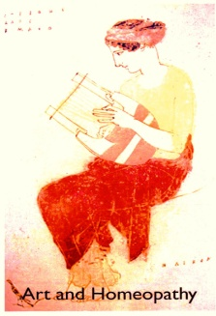


Slide 2
How art can be healing if you let it be part of your own expression

Slide 3

Why art and homeopathy?
It’s because homeopathy is about healing, because art is known to be healing and because art also is an expression of individuality and creativity.
Homeopathy is individualised medicine which depends on hearing/sensing/observing all that a patient has to show about their suffering so that it can be cured.
It relies on personal expression. Art is a way in which people can show their inner self and that is what we are looking for in homeopathy. It is the individual and not just the disease we are interested in.

Slide 4
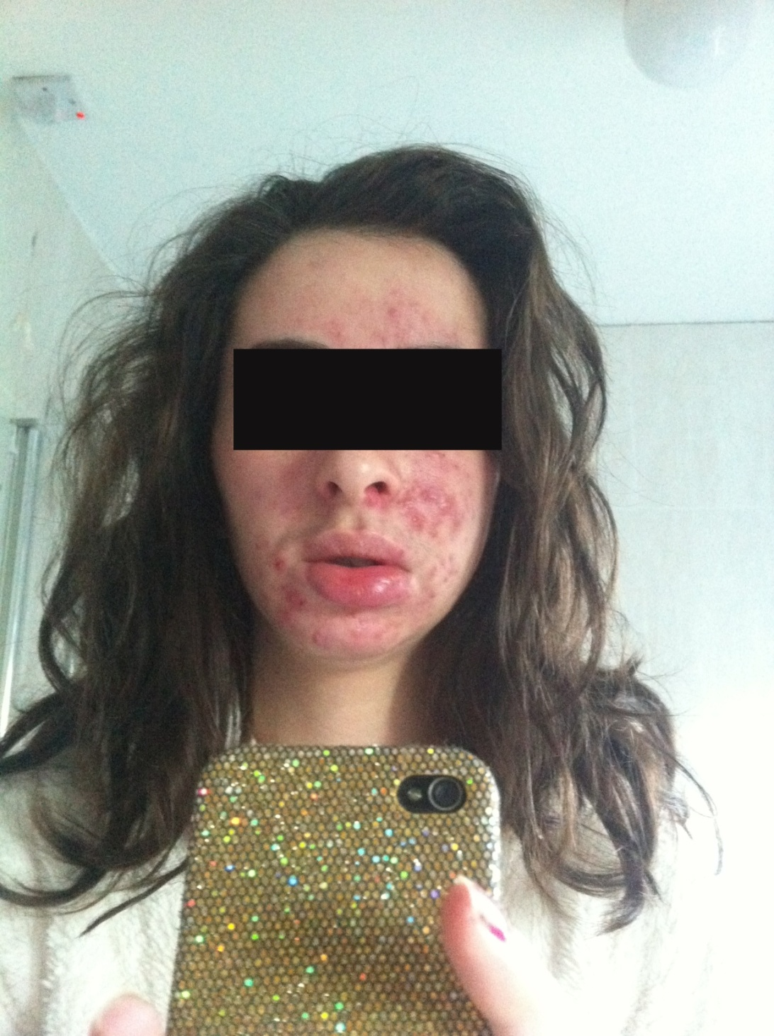

This is the case
of a young woman,
an artist with chronic
cystic acne, an unhappy
love life and menstrual
problems and how her
own art work showed
the way to the cure.

Slide 5
Interact with the case
All her work, from her art degree show, reflects her understanding of the natural world and its connection with the cycles of our own bodies and lives.
Look at the images and listen to her own descriptions and feelings about what she was trying to do and reflect that it also tells her own story.

Slide 6
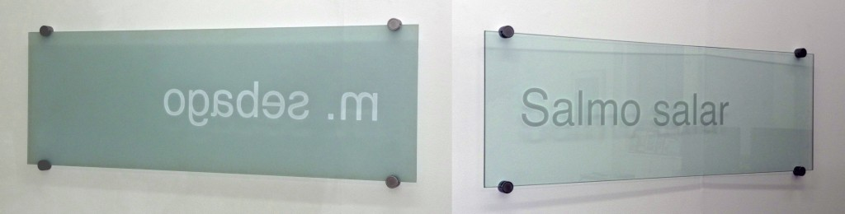

Art installation
Etched letters on glass – Helvetica Face

Slide 7
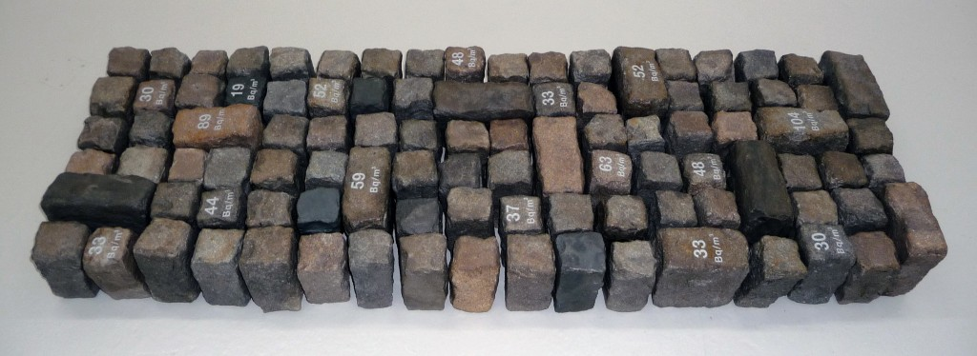
Granite sets with Bequerel values

Slide 8

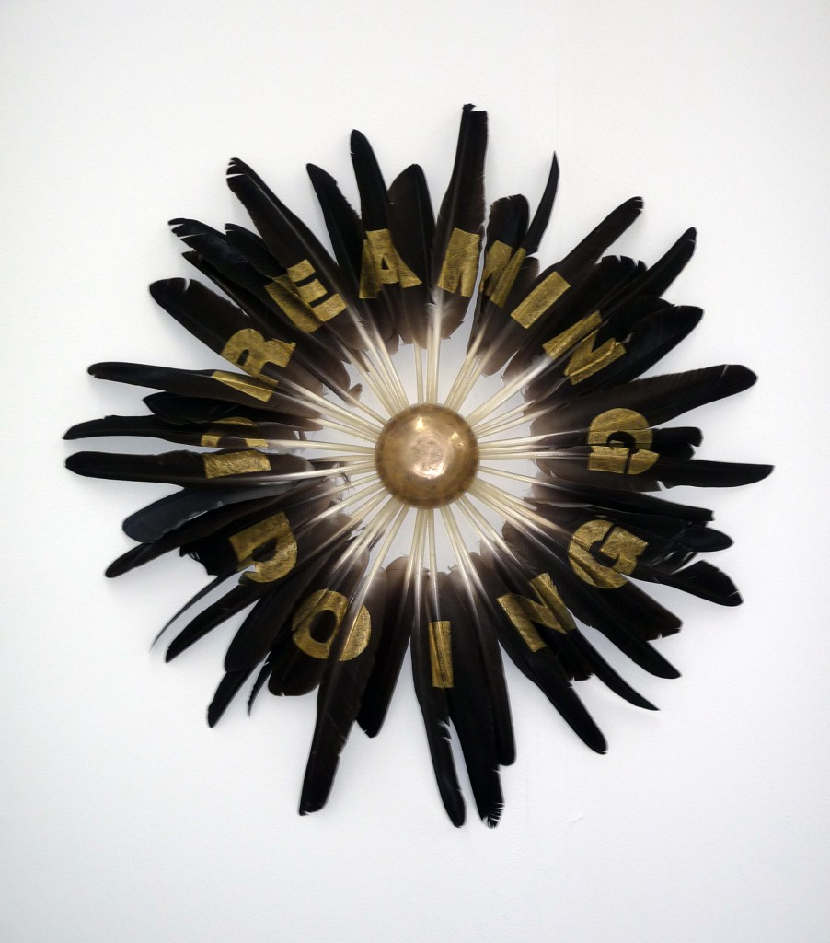
Geese
feathers
arranged
in letter
form

Slide 9

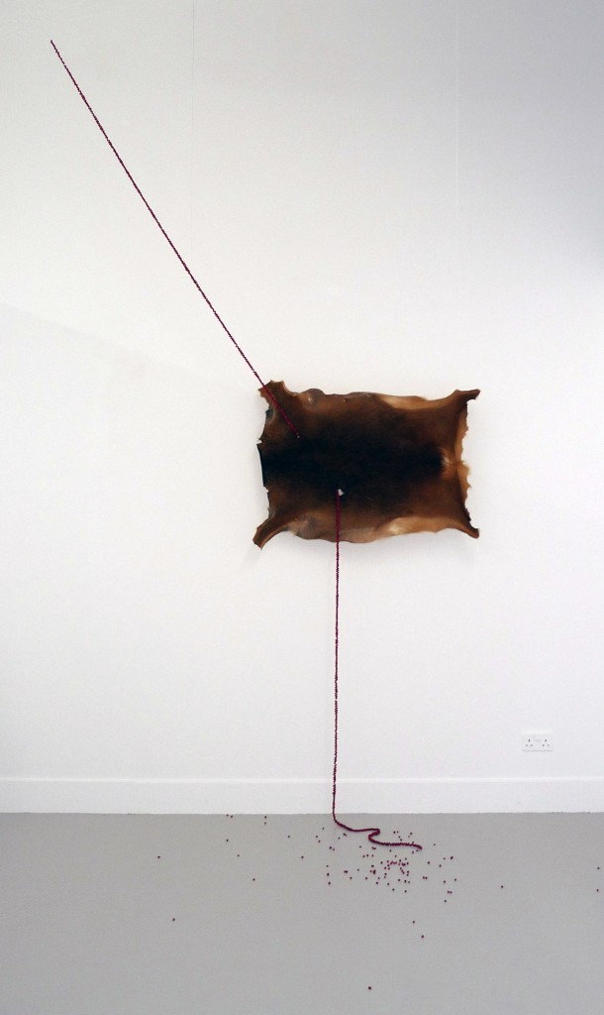
Deer
hide and
rowan
berry
installation

Slide 10
Deer and Rowan
“What befalls the earth befalls all the sons of the earth. This we know: the earth does not belong to man, man belongs to the earth. All things are connected like the blood that unites us all. Man does not weave this web of life. He is merely a strand of it. Whatever he does to the web, he does to himself”. Chief Seattle (1786 – 1866)
Rowan berries emerge in the gallery as if from nowhere and penetrate the deer hide through the entrance and exit holes left by a bullet. The straight angular line of berries entering the hide creates tension, reflecting the anticipation before the kill. During its life the Rowan berries (a symbol of protection) fed the deer, now after its death they fertilise the soil for new growth.

Slide 11

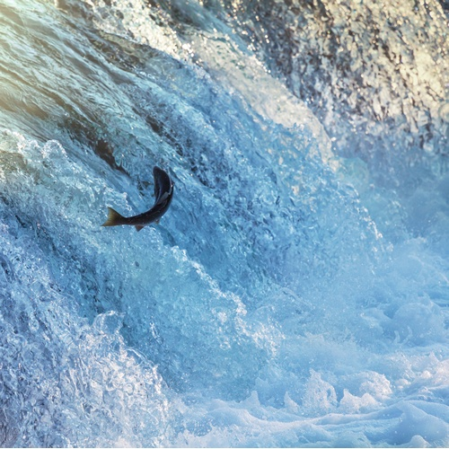
Which remedy did she have?
  Oncorhynchus tshawytscha (Pacific
  Chinook salmon)

Slide 12
Salmon theme
Sudden, deep belief and conviction that I would find my soul mate or life partner. Remembering how I had always been with the wrong man. Where is my love? Dreams of love. Dreams of my soul mate. Deep, yearning, empty feeling. I feel hollow inside. Such a deep hunger, but not for food – for something greater, for the other half of myself, which feels stuck, or lost, in time and space. Deep, deep sorrow. I question what would happen if I ever merged with my other half. What would there be then? The cycle would continue and separation would follow. Cycles, as separation, connection and completion.

Slide 13

Salmon theme
I want to get engaged and married. I want to settle down and get pregnant, and have a family. Strong desire for a home and a relationship. Not feeling at home in my original home. Huge sadness of something missing, of not knowing where my home is. I don’t know where my place is. Should I be going home, or not? And where is home anyway?

Slide 14

A salmon myth
A chief had a daughter whom many wanted to marry but he was unwilling to part with her. He set a contest in which whoever could break a pair of elk antlers would be allowed to marry his daughter. Many animals tried but could not break the antlers. There was one person in the house whose body was full of sores and boils. When that person arose and shook his body and blankets and hair, his body became clean, his hair long and full. He was very beautiful and the chief saw that he was the Salmon. Salmon broke the antlers in five pieces, threw them down and ran away with the chief’s daughter.

Slide 15
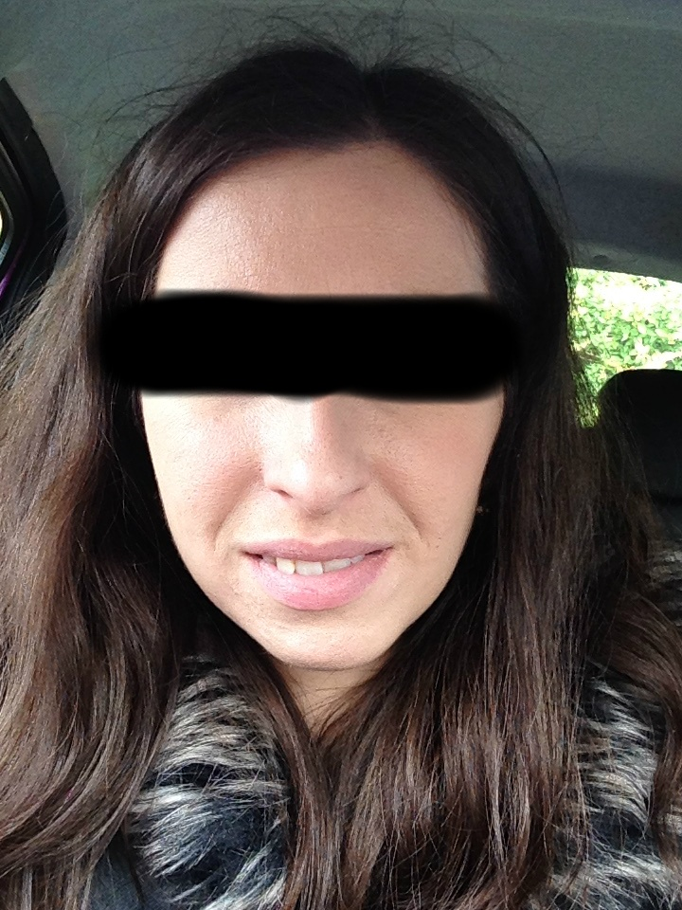

Slide 16
Why salmon?
The whole case is about themes of the natural world; cycles, survival, individuality.
The art works are all about these things, how they inhabit the themes and are a part of the woman’s perception of the world and her own world
The salmon has been used as a homeopathic remedy for many menstrual and fertility problems - it has history here
It contains all the themes she is trying to portray and stands for her work and her dis-ease.

